Slide 1

H1B Case Status Prediction
Janvi Kothari
Jinal Jain
Mihin Sumaria
Mihir Sawant
Rushikesh Naidu
http://trak.in/tags/business/2013/04/02/h1b-visa-lottery-2013/

Slide 2
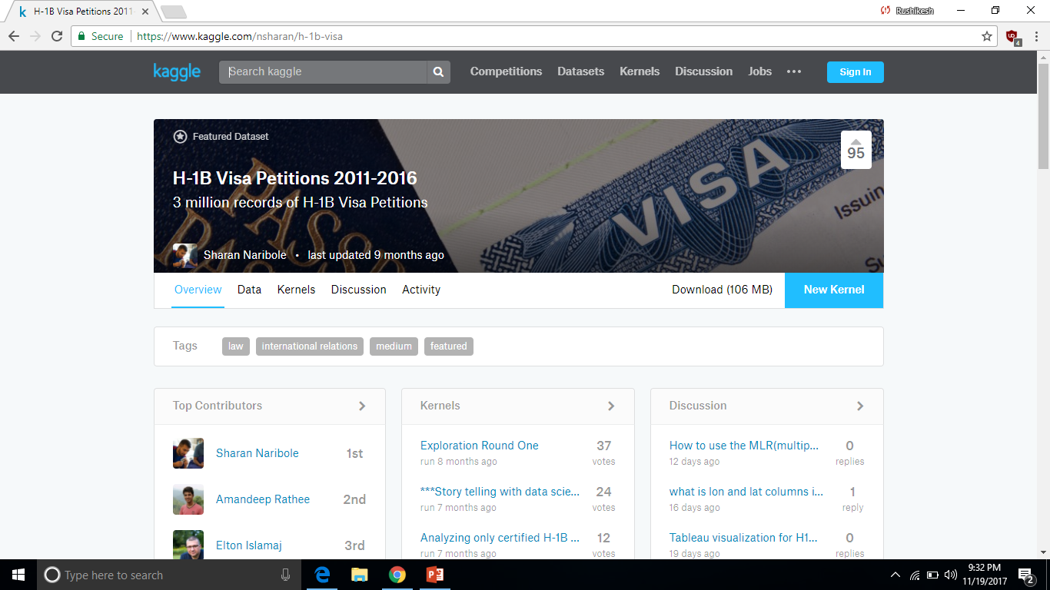
MOTIVATION
Vital for international residents who wish to work in the United States
Requires sponsorship and is an expensive process
https://www.kaggle.com/nsharan/h-1b-visa

Slide 3
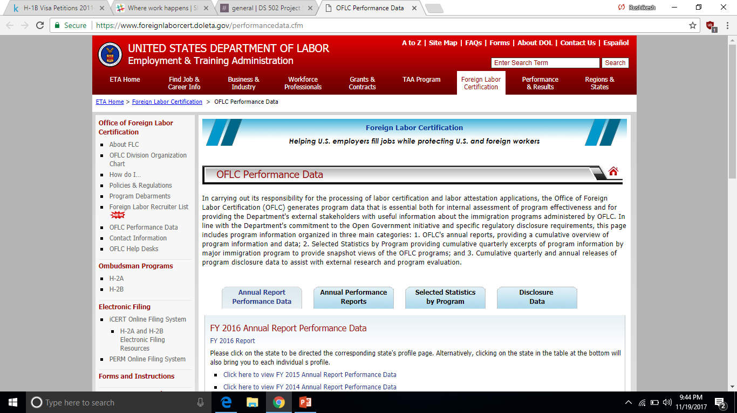
Source
https://www.foreignlaborcert.doleta.gov/performancedata.cfm

Slide 4
Dataset
File Size : 245.285MB
Number of Observations : 645241
Number of Variables : 52
Categorical Variables: 29
Numerical Variables:23

Slide 5
Problem Statement
Based on this set of known predictors can we predict whether a person’s H1B visa will be approved or not ?
And if we can indeed predict , IS IT A LOTTERY?

Slide 6
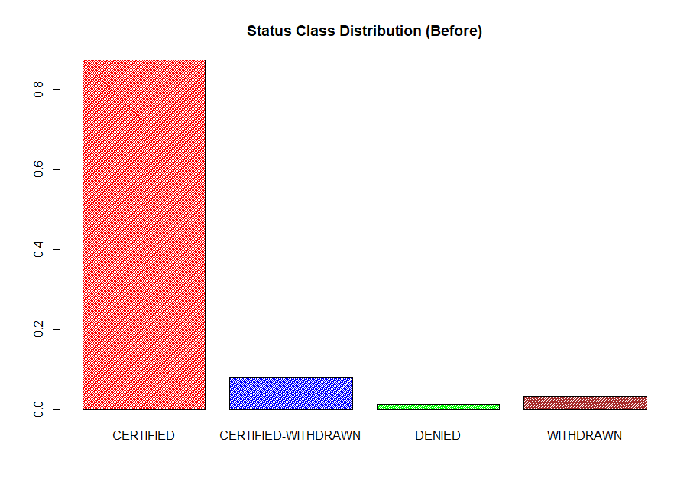
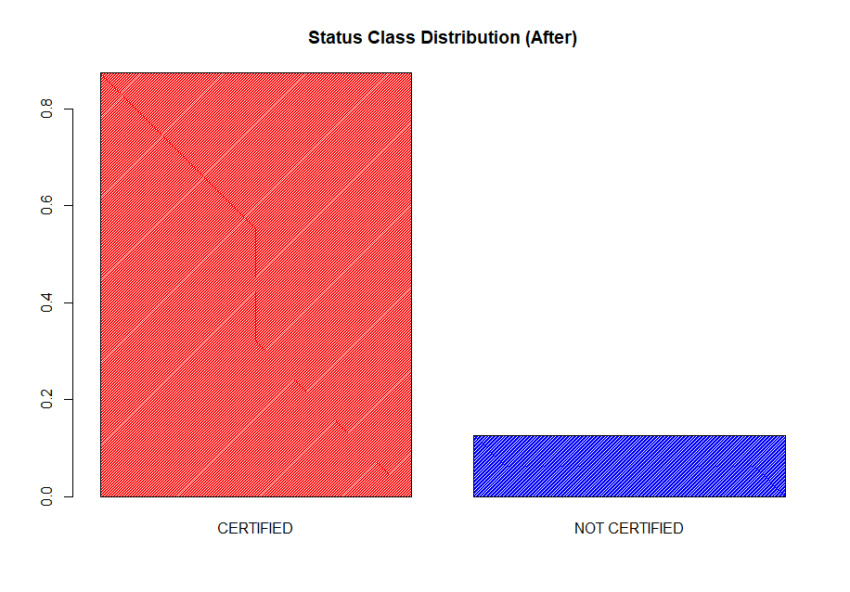
Response Variable - Case Status

Slide 7
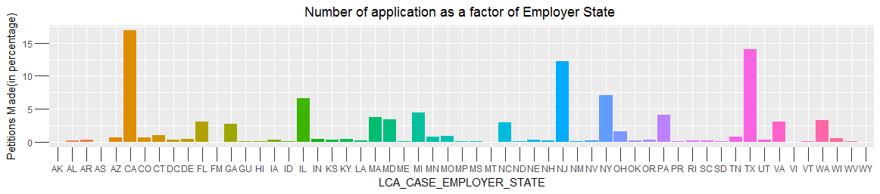
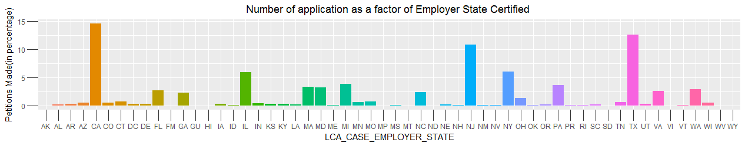
Exploration

Slide 8
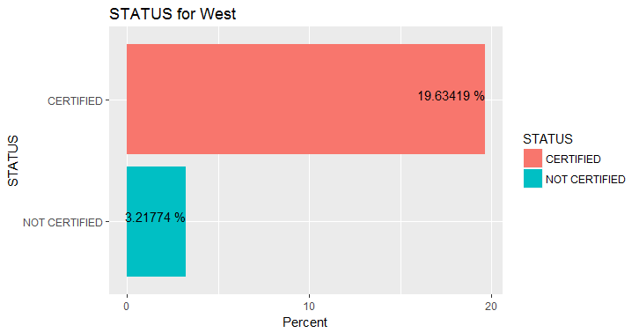
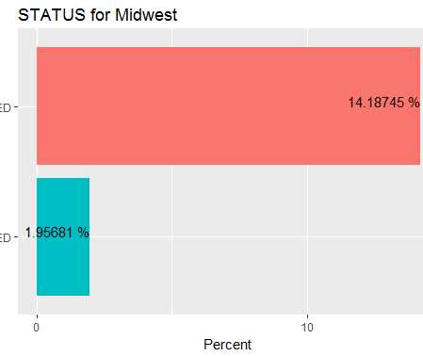
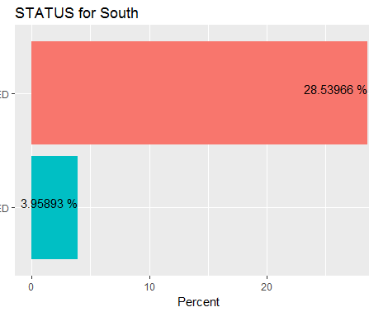
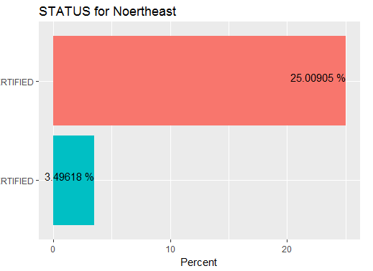
Geographical Analysis

Slide 9
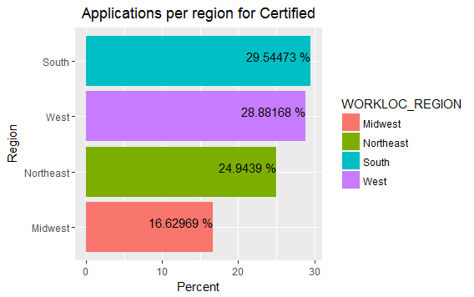
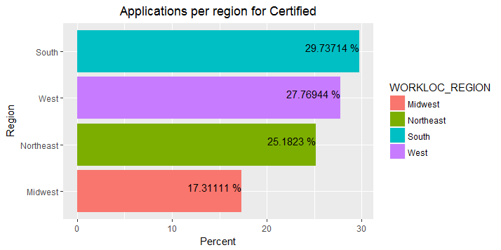
CERTIFIED | NOT CERTIFIED

Slide 10
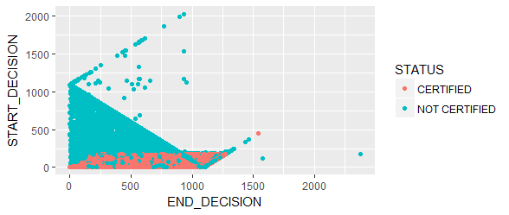
Analysis Based on Dates

Slide 11

Preprocessing
Removing N/As
Correcting Class Imbalance
Removing Insignificant Variables
Feature Engineering
Designed New Variables

Slide 12
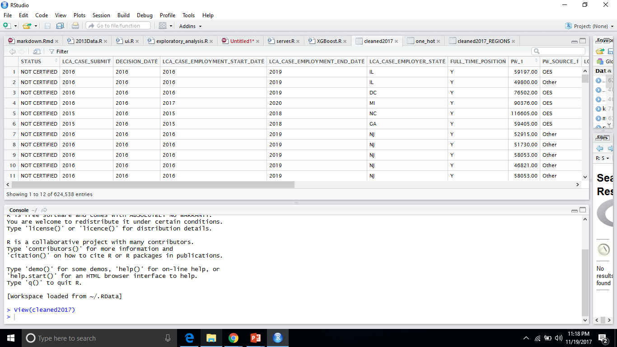
Processed Data
FILE SIZE: 81 MB
NUMBER OF OBSERVATIONS: 6,24,538
NUMBER OF VARIABLES: 22
CATEGORICAL VARIABLES: 8
NUMERICAL VARIABLES: 14

Slide 13
Class Imbalance - Solutions
Under-sampling
Over-sampling
Both
XGBoost

Slide 14
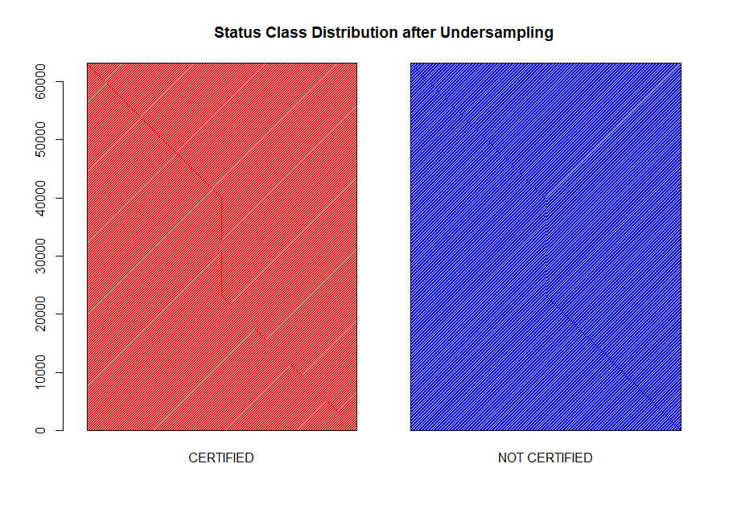
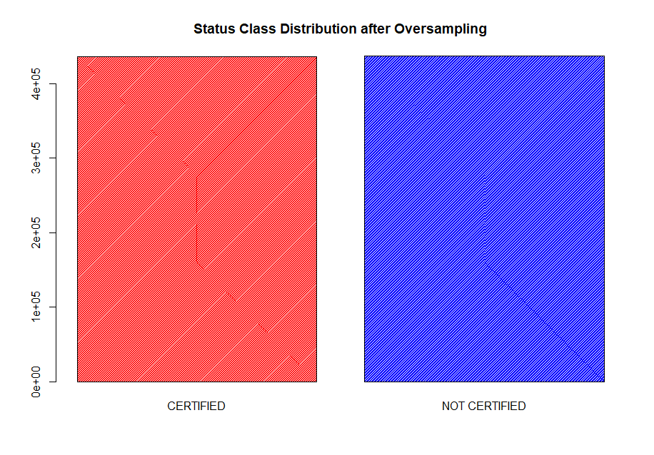
Sampling
R Package ‘ROSE’ - Random Over-Sampling Examples

Slide 15
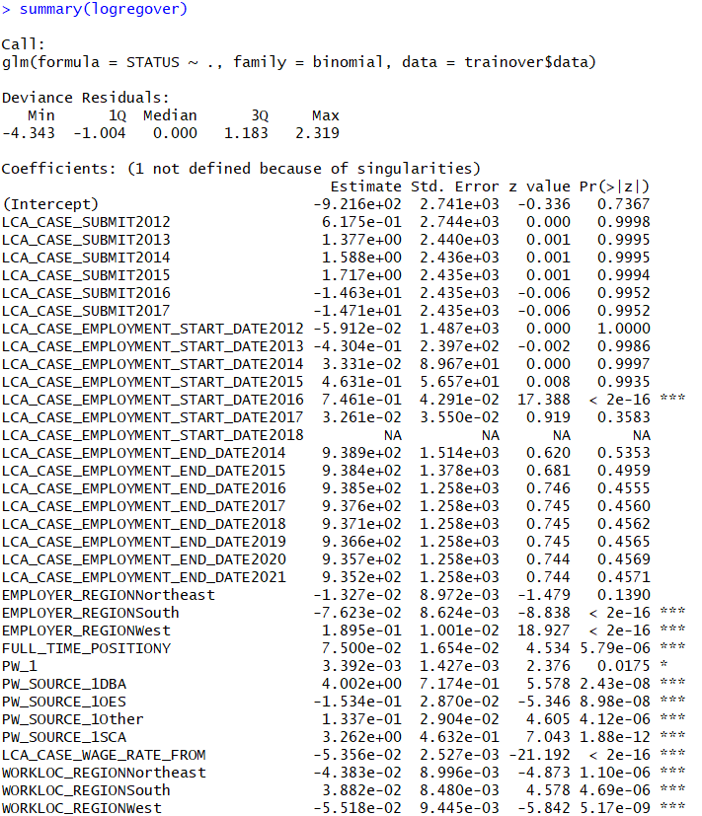
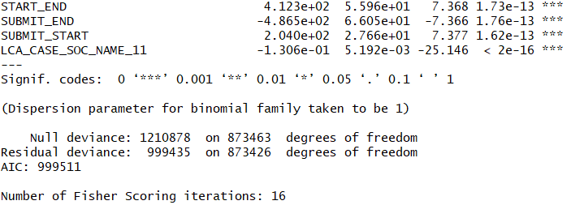
Logistic Regression
Notes:
Linear model
On under, over, both, all
Best results over
Significant variables

Slide 16
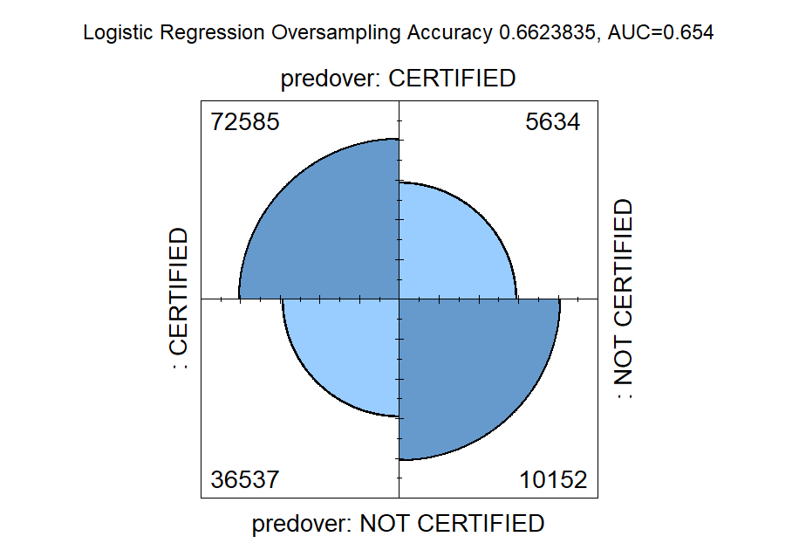
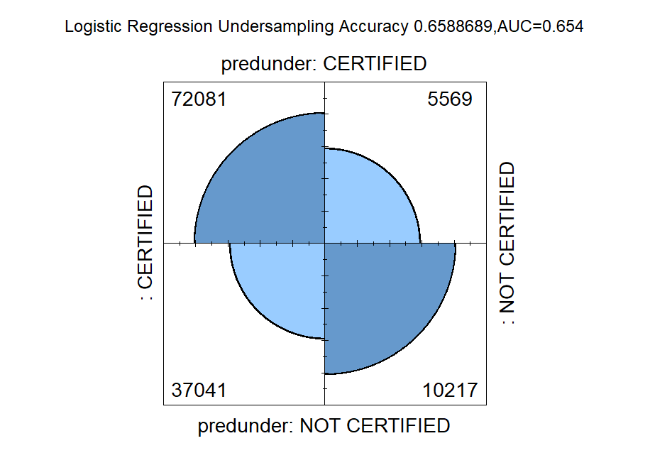
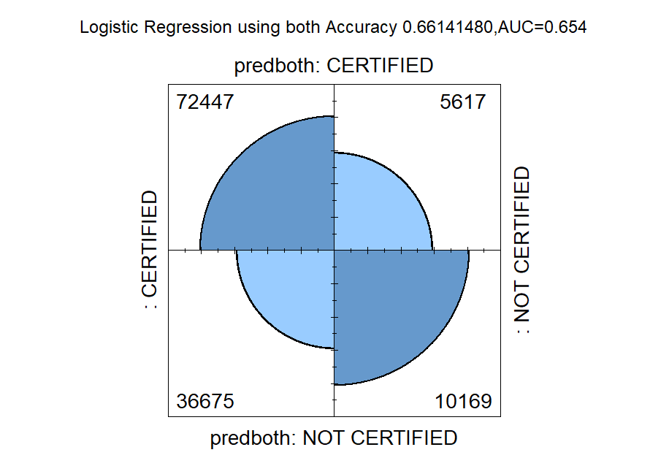
Logistic Regression Confusion Matrix

Slide 17
KNN
Results from KNN : K=20
 | Under sampled Dataset | Over sampled Dataset | Original Dataset
Test Accuracy : | 68.75% | 74.67% | 91.33%
Predicted | Actual
 |  | CERTIFIED | NOT CERTIFIED
 | CERTIFIED | 162932 | 15599
 | NOT CERTIFIED | 636 | 8195
Notes:
KNN is one of the most basic methods when going for classification.
Computing time for KNN is highest among all the other methods for this dataset.
KNN requires all data to be in numeric form. Hence all categorical attributes were transformed to one-hot encoded variables & numeric attributes were normalized.
Since it is said that the best value of k would be $\sqrt{n}$ where n is the number of data points, we tried taking k=800. However that was too computationally expensive in terms of time.
Tried k=499.
Tried different values of k ranging from k to 1 to 499. Best k obtained = 20.
Unable to perform cross validation since the computational time for this was extremely high considering the size of this data set.
KNN also suffers from the curse of dimensionality; hence we implemented other methods.

Slide 18
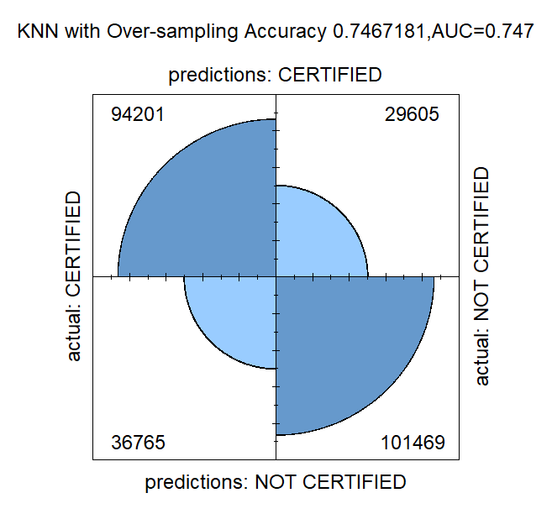
Over-Sampling

Slide 19
Recursive Partitioning RPART
Creates binary decision trees.
Recursively partitions sub-populations based on different predictors.
Splitting terminates after stopping criterion.
Creates decision rules that has more sensitivity and specificity.
May cause overfitting.

Slide 20
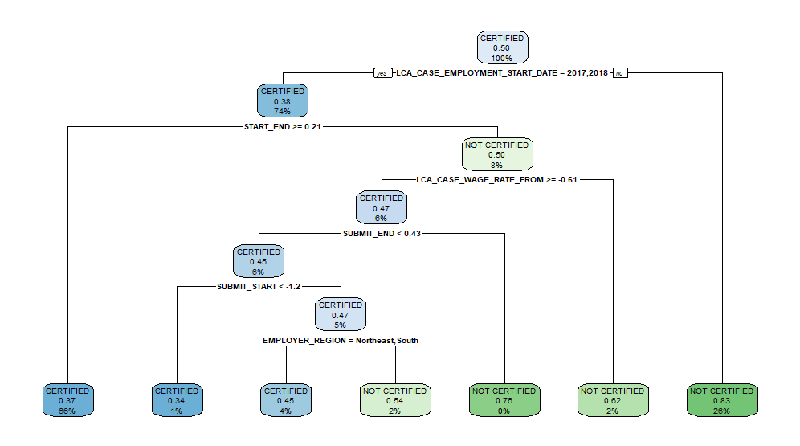
Recursive Partitioning and Regression Trees RPART

Slide 21
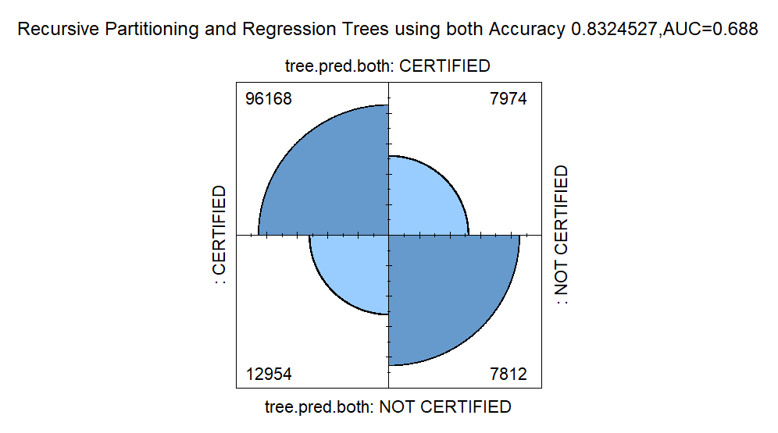
RPART Confusion Matrix

Slide 22
Using Turing Cluster
Why Turing Cluster?
Each node has a minimum of 64 GB RAM
Scheduling algorithms like Random Forest in a distributed manner, over multiple nodes.
Reduced process times

Slide 23
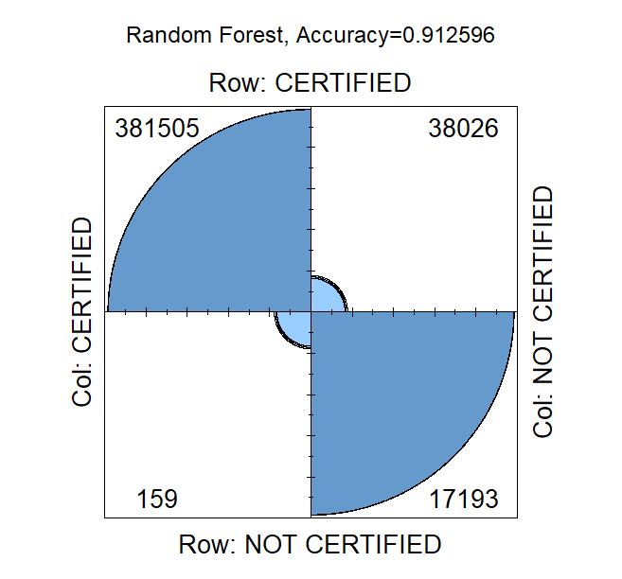
Random Forests

Slide 24
eXtreme Gradient BOOSTing (XGBoost)
Iteratively combines a number of “weak” learners to create a strong classifier.
The weak learner here is a decision tree.
The learners are added based on a loss function which is to be minimized at each iteration.
Regularized model formalization to control over-fitting.
Parameters:
max.depth = 15
eta = 0.5
nrounds = 19
Model takes 2 seconds to run

Slide 25
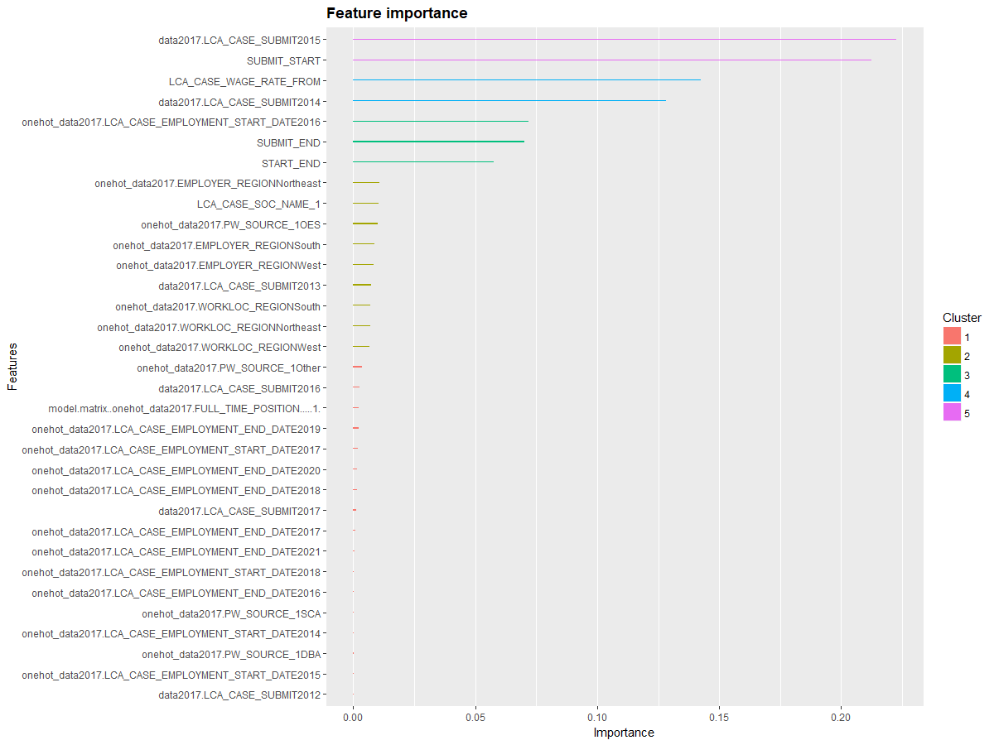

Slide 26
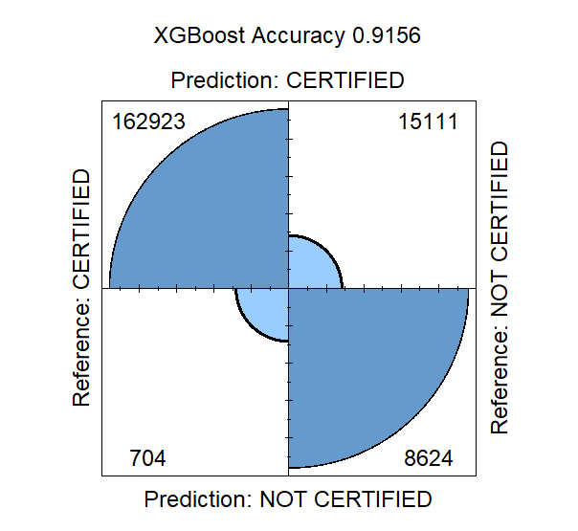
ROC-AUC = 0.7875

Slide 27
Results
Given a set of predictors there is a good chance that we can predict whether an applicant could be certified or not.

Slide 28
Future Scope
The project is incorporated on 2017 data. Levying our model on data from 2011- 2016 , we can see if there has been a change in any of the predictor’s significance.
For a particular employer, we can design a customized model where the employer can predict whether the applicant will be certified.

Slide 29
Thank you ☺

